Slide 1

Network FLOW optimization for a pharmaceutical company
Group 20
Members:
Suharsha Fernando - w1761093 – 2019351
Tharindu Wickramasinghe - w1761352 – 2019448
Nivin Sajanaka Hennadige - w1761354 – 2019452
Vajith Chamuditha - w1761107 - 2019437

Slide 2
Content
INTRODUCTION
1
2
PROBLEM DOMAIN
REASON TO CHOOSE THE PROBLEM
3
4
OBJECTIVES OF THE SOLUTION
EVALUATION OF EXISTING RESEARCH
5
6
PROBLEM DATA WITH SOLUTION MODEL
IMPLEMENTATION
7
8
CONCLUSION

Slide 3

Introduction
With rising costs optimization has become an essential part in any business.
Transmed International (Pvt) Limited is a medical supply store company in Sri Lanka which has factories in nine different locations in Western Province (Kalutara, Dehiwala, Moratuwa, City Center, Weyangoda, Narahenpita, Slave Island, Horana, Biyagama).
This company supplies immune suppressor capsules for AIDS and they distribute those to the distributer of their own city.
To optimise the transportation we use network flow optimisation in linear programming.

Slide 4
Problem Domain
Transportation optimization deals with finding the most efficient way to transport goods or people.
Pharmaceutical transportation optimization is the practice of improving the efficiency of transporting pharmaceutical products by finding the most effective and cost-efficient ways to move them from one location to another.
This involve strategies such as choosing the most efficient routes, selecting the right vehicles and carriers.
The goal of pharmaceutical transportation optimization is to ensure that pharmaceutical products are delivered on time and in good condition thus minimizing the cost & environmental impact of transportation.

Slide 5

Problem Domain cont…
With the rising demand of these capsules in some cities, the demand cannot be fulfilled properly due to limited capacity of stocks available in each factory, while in certain cities demand decreases due to an excess of capsules.
Based on the above problem, cost negligence can have a direct impact on the profit of the company.

Slide 6
Why Transportation Optimization For A
Pharmaceutical Company?
Optimizing transportation ensure medications reach their destination on time and in good condition.
By choosing the most efficient routes and carriers, companies can reduce the amount of fuel consumed and emissions produced.
By optimizing pharmaceutical transportation, companies can improve their bottom line and provide better service to their customers.

Slide 7
Objectives
Minimize the Transportation & additional cost
Determine the most convenient method of delivering the units
Increase the profitability
Increasing the company's goodwill by meeting the demand

Slide 8
Evidence of the research on models and methods
Citation | Brief description | Algorithm used
(Antonio G.N. Novaes et al.2011) | Development of a computational system to determine the optimal bus stop spacing to reduce travel time for all passengers | Nonlinear programming
(Lakshmi & Suresh M, 2017) | A cost optimization approach for the delivery of goods for a flavors and fragrance company is presented. | EXCEL solver
(Sang et al., 2021) | Development of a solution that helps businesses determine the optimal transportation. plan and assist in making decisions on allocating goods to locations. | Linear Programming
(Banik & Zahid Hasan, 2018) | Determination of the optimum & reliable transportation cost of an online business | Vogel’s approximation method
Table 1.1

Slide 9
Various Methods For Solving This Problem
According to (Szkutnik-Rogoż et al., 2021), there are several alternative manual approaches to solve the transportation problem. They are,
North-West corner method
Least Square method
VAM (Vogel’s Approximation Method)

Slide 10
Pros & Cons Comparison
Of Linear Programming
There should be an objective which should be clearly identifiable and measurable in quantitative terms
Improves the quality of decisions
Helps in attaining the optimum use of productive resources
PROS
CONS
Doesn’t take the effect of time & uncertainty into consideration
Helps to arrive at the optimal solution to a decision problem by taking into account constraints on the use of resources
Deals with only a single objective

Slide 11
The table provides the cost of delivery per lot of units from one city to another.
Cities | Kalutara | Dehiwala | Moratuwa | City Center | Weyangoda | Narahenpita | Slave Island | Horana | Biyagama
Kalutara | 0 | 10000 | 7000 | 16000 | 5000 | 20000 | 5000 | 7000 | 8000
Dehiwala | 10000 | 0 | 18000 | 22000 | 22000 | 3000 | 7000 | 14000 | 13000
Moratuwa | 7000 | 18000 | 0 | 18000 | 25000 | 24000 | 17000 | 22000 | 19000
City Center | 16000 | 22000 | 18000 | 0 | 22000 | 28000 | 2000 | 14000 | 8000
Weyangoda | 5000 | 22000 | 25000 | 22000 | 0 | 18000 | 11000 | 6000 | 9000
Narahenpita | 20000 | 3000 | 24000 | 28000 | 18000 | 0 | 7000 | 14000 | 12000
Slave Island | 5000 | 7000 | 17000 | 2000 | 11000 | 7000 | 0 | 8000 | 6000
Horana | 7000 | 14000 | 22000 | 14000 | 6000 | 14000 | 8000 | 0 | 12000
Biyagama | 8000 | 13000 | 19000 | 8000 | 9000 | 12000 | 6000 | 12000 | 0
Table 2.1

Slide 12
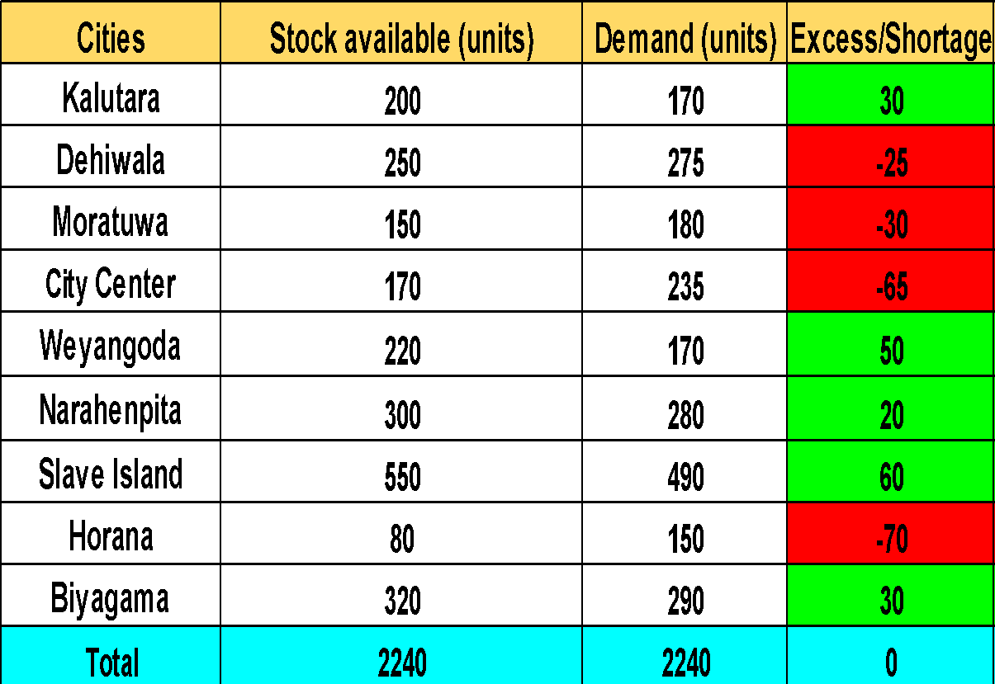

Problem Data
A mismatch of available stocks and demand is present. Some have surplus in quantity while some have deficit in quantity.
Total Demand = Total Distribution Capacity.
Table 3.1

Slide 13
Below Tables Are The Demand Nodes And Supply Nodes
Supply | No of supply (units)
Kalutara | 30
Weyangoda | 50
Narahenpita | 20
Slave Island | 60
Biyagama | 30
Total | 190
Table 4.1
Demand and Supply are same when considering the tables . Hence, Linear Programming Network Models Approach can be used. For this case, Demand node - the cities where shortage of units Supply node - cities where excess of units are present.
Demand | No of demand (units)
Dehiwala | 25
Moratuwa | 30
City Centre | 65
Horana | 70
Total | 190
Table 4.2

Slide 14
Network Flow Of The Problem
 | Demand
Dehiwala | 25
 | Supply
Kalutara | 30
 | Demand
Moratuwa | 30
 | Supply
Weyangoda | 50
 | Supply
Narahenpita | 20
 | Demand
City Center | 65
 | Supply
Slave Island | 60
 | Demand
Horana | 70
 | Supply
Biyagama | 30

Slide 15
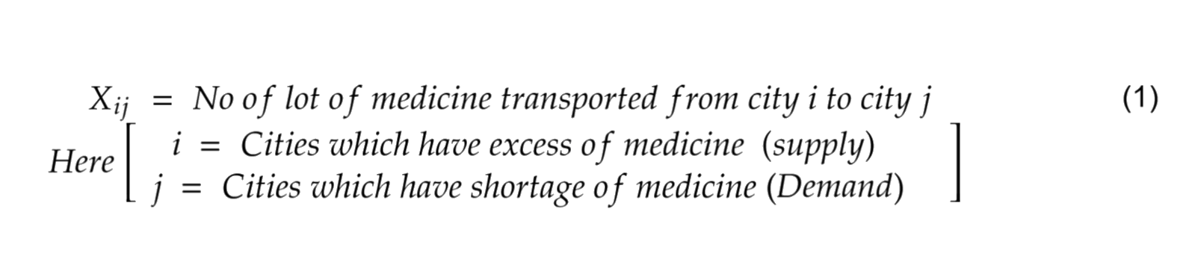
Mathematical Model of the Problem
Linear Programming Formulation
1) Decision variables

Slide 16
1) Decision Variables cont.…
The supply nodes are defined as S1, S2, S3, S4:
S1 = Kalutara
S2 = Weyangoda
S3 = Narahenpita
S4 = Slave Island
S5 = Biyagama
The demand nodes are defined as D1, D2, D3, D4:
D1 = Dehiwala
D2 = Moratuwa
D3 = City Center
D4 = Horana

Slide 17
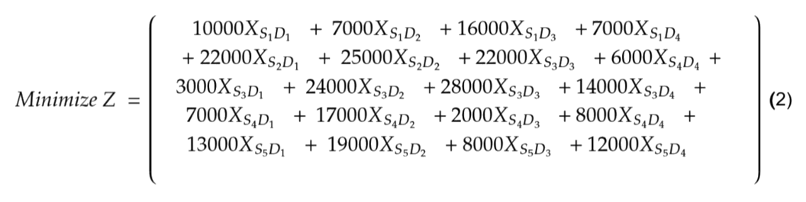
2) Identifying the Objective Function
The objective of the company is to minimize the transportation cost. Hence, we can derive the objective function as:

Slide 18
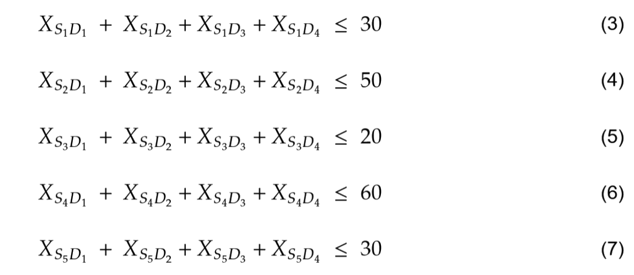
3) Constraints Of Supply Node
When defining constraints, we should evaluate everything which can have a restricting influence on the desired objectives.
In our scenario we have identified the following as constraints:
Every destination a single warehouse supply should be less than or equal to its capacity

Slide 19
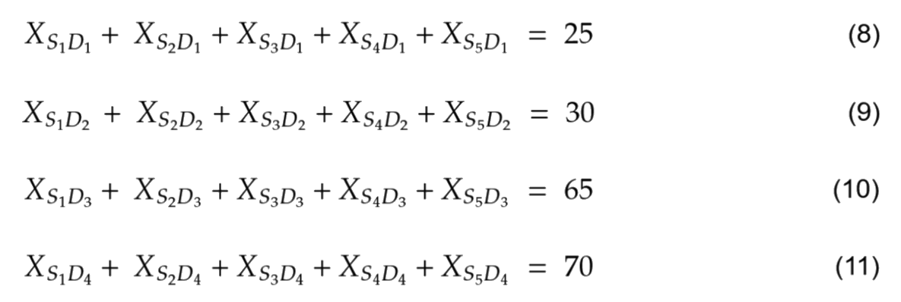
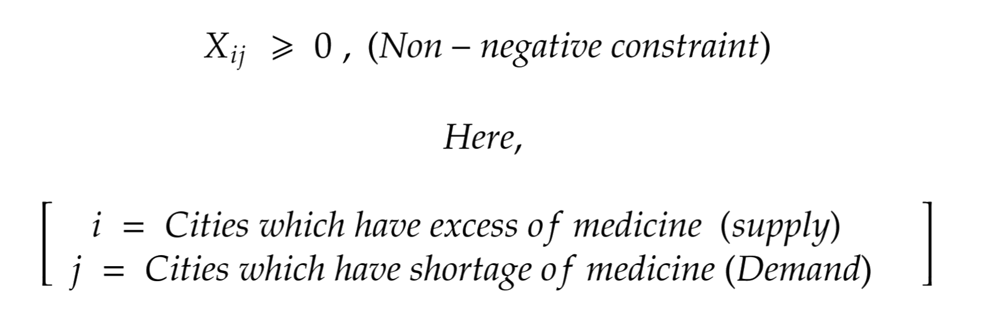
4) Constraints Of Demand Node
Supplies from each warehouse for a single city should fulfill its demand.
Since this is a real-world problem, all values should be positive.

Slide 20
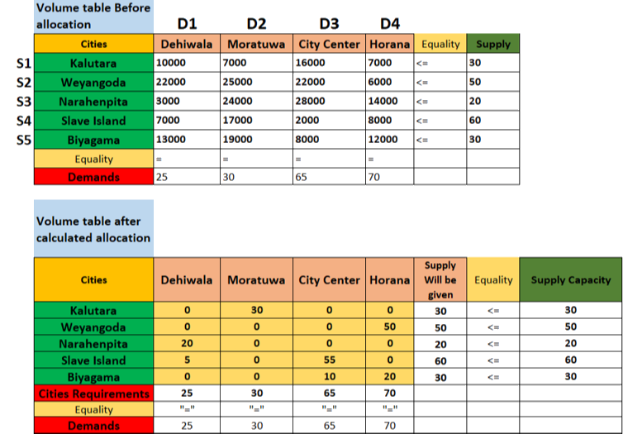

Implementation Using Excel Solver

Slide 21
Illustration of the result obtained using excel solver
 | Demand
Dehiwala | 25
 | Supply
Kalutara | 30
30 x 7000 =210,000
 | Demand
Moratuwa | 30
 | Supply
Weyangoda | 50
20 x 3000 =60,000
 | Supply
Narahenpita | 20
50 x 6000 = 300,000
5 x 7000 =35,000
 | Demand
City Center | 65
 | Supply
Slave Island | 60
55 x 2000 =110,000
10 x 8000 =80,000
 | Demand
Horana | 70
 | Supply
Biyagama | 30
20 x 12000 =240,000
Total Cost = LKR 1,035,000.00

Slide 22

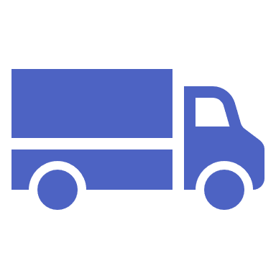
By using Network Model Approach the company can find the optimal way to transport these items at minimum cost.
CONCLUSION
From the above solution it can be clearly conclude that using excel solver solution we can determine the best optimal solution for saving cost of distribution expenses.

Slide 23
References
Banik, D., & Zahid Hasan, M. (2018). Transportation Cost Optimization of an Online Business Applying Vogel’s Approximation Method. World Scientific News, 96, 179–190. www.worldscientificnews.com
Lakshmi, & Suresh M. (2017). Cost Optimization for Transportation Using Linear Programming. https://doi.org/10.47750/cibg.2017.23.01.006
Sang, T. T., Minh Thu, N., Hoang Khoi, T., Thi Kim Huong, N., Lan, L. T. N., & van Thanh, N. (2021). The Optimization of Transportation Costs in Logistics Enterprises during the Covid-19 Pandemic. ARRUS Journal of Mathematics and Applied Science, 1(2), 62–71. https://doi.org/10.35877/mathscience567

Slide 24


